Slide 1

Deploy your Data Project on the Web Using Only Python Taipy
February, 2024
Presented by Alexandre Sajus
1
Notes:
Intro: … présenter Taipy, notre outil qui permet de déployer son projet d’analyse de données dans un navigateur en utilisant uniquement Python

Slide 2
The Problem
Only 13% of Data Projects make it into Production
While companies spent 271B$ on Data Projects
Sources: VentureBeat 2017, Why do 87% of data science projects never make it into production?
Fortune Business Insights 2022, Big Data Analytics Market Size
2

Slide 3






The Causes
Only 23% of companies find the right talent.
Data
Data Engineer
Data Scientist
Dev
Ops
Front-End
End user
Source: IDC 2020 FutureScape: Worldwide Data and Analytics 2021 Predictions
3
Notes:
Se concentrer sur pq c’est important d’avoir l’utilisateur tôt

Slide 4
The Causes
Almost 90% of data projects take too long, are too costly to develop and deploy.
Source: IDC 2020 FutureScape: Worldwide Data and Analytics 2021 Predictions
4

Slide 5
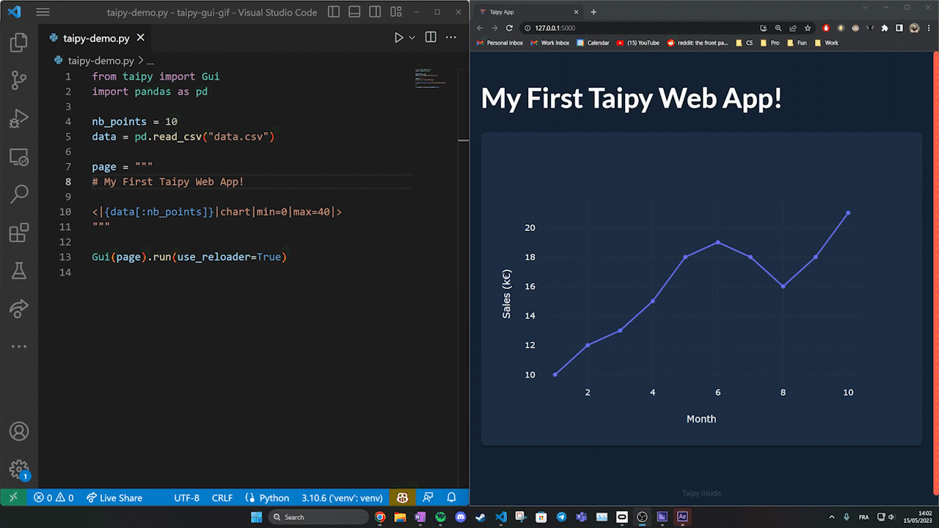
Taipy Front
Taipy deploys your Data Analytics more easily
Talent: Web Application coded in Python, no need to outsource front-end skills
Time & Cost:
Reduces your required tech stack to Python only
Deploy in a few lines of code
User faster in the loop

Slide 6
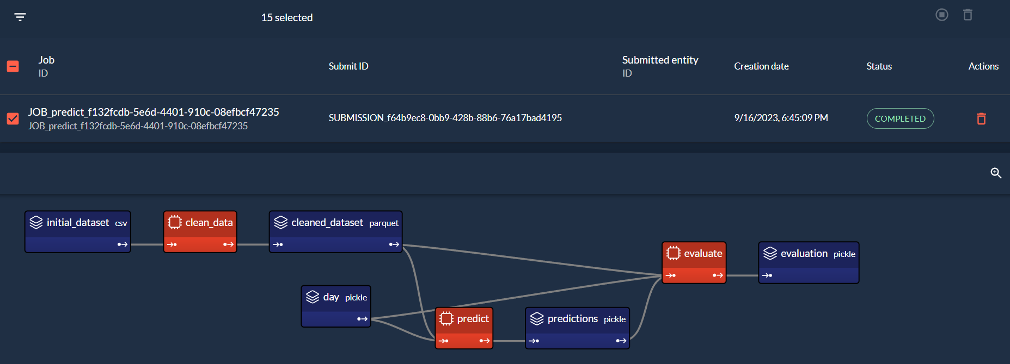
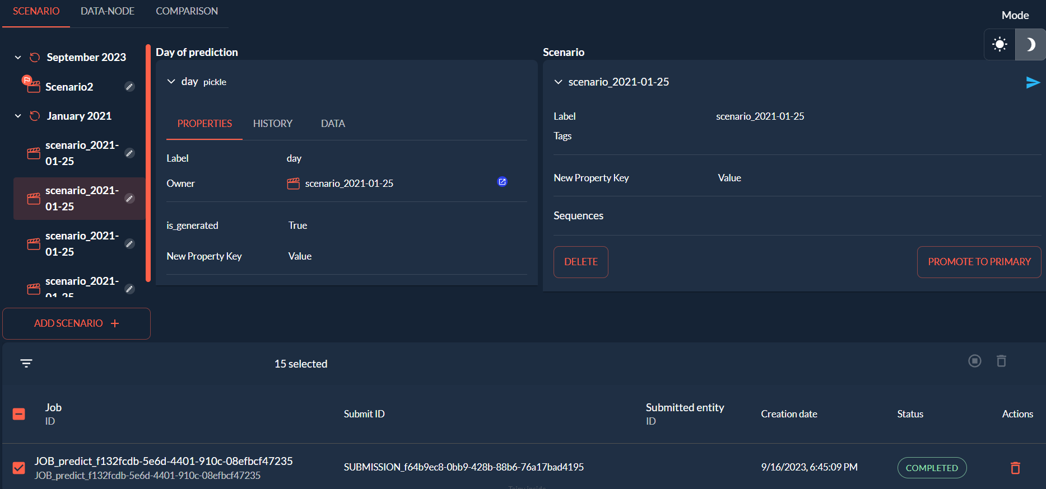
Taipy Back
Taipy helps the end-user manage data pipelines
Talent:
Connects your data pipelines to the front-end easily
Puts user in the loop early
Time & Cost:
Taipy saves and versions your pipeline’s results
Does not re-run what does not need to be
Runs tasks in parallel, on distributed clusters
Easy to plug common data sources

Slide 7
Same Result Cost Reduction
factor 10 !
Project Example: Intermarché’s Cash Flow Management | Budget | Number of IT personnel | Project Duration
Initial Option | 600K$ | 4 | 8 Months
Intermarché’s IT Div using Taipy | 60K$ | 2 | 2 Months

Slide 8









Positioning
Completeness of solution
Python Graphical Packages
Ease of coding

Slide 9


